Slide 1
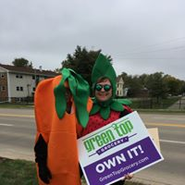
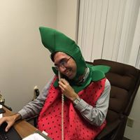
Volunteer Recruitment
& Retention

Slide 2
Katie Novak
  State Farm Insurance
  SAME Café (So All May Eat)
  Homes of Hope, Inc.
  Green Top Grocery
  Katie Novak Cooperative Coaching

Slide 3
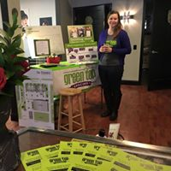
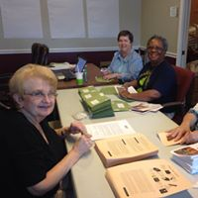
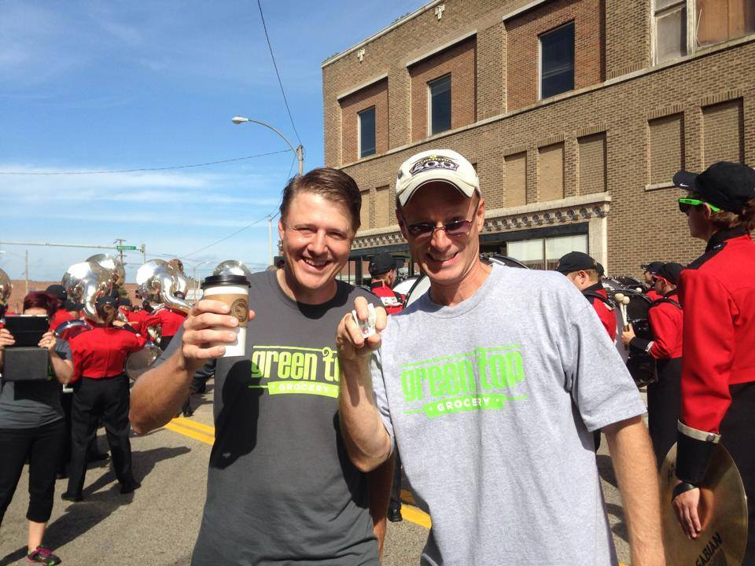
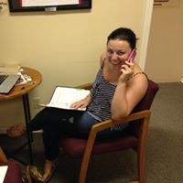
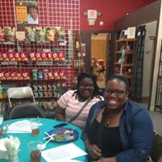
Volunteer Roles
Notes:
Yard sign courier
Owner packet stuffer
Grant writing
Board member
Committee Member
Tabler
Manual labor
Graphic design
Accounting
Legal

Slide 4
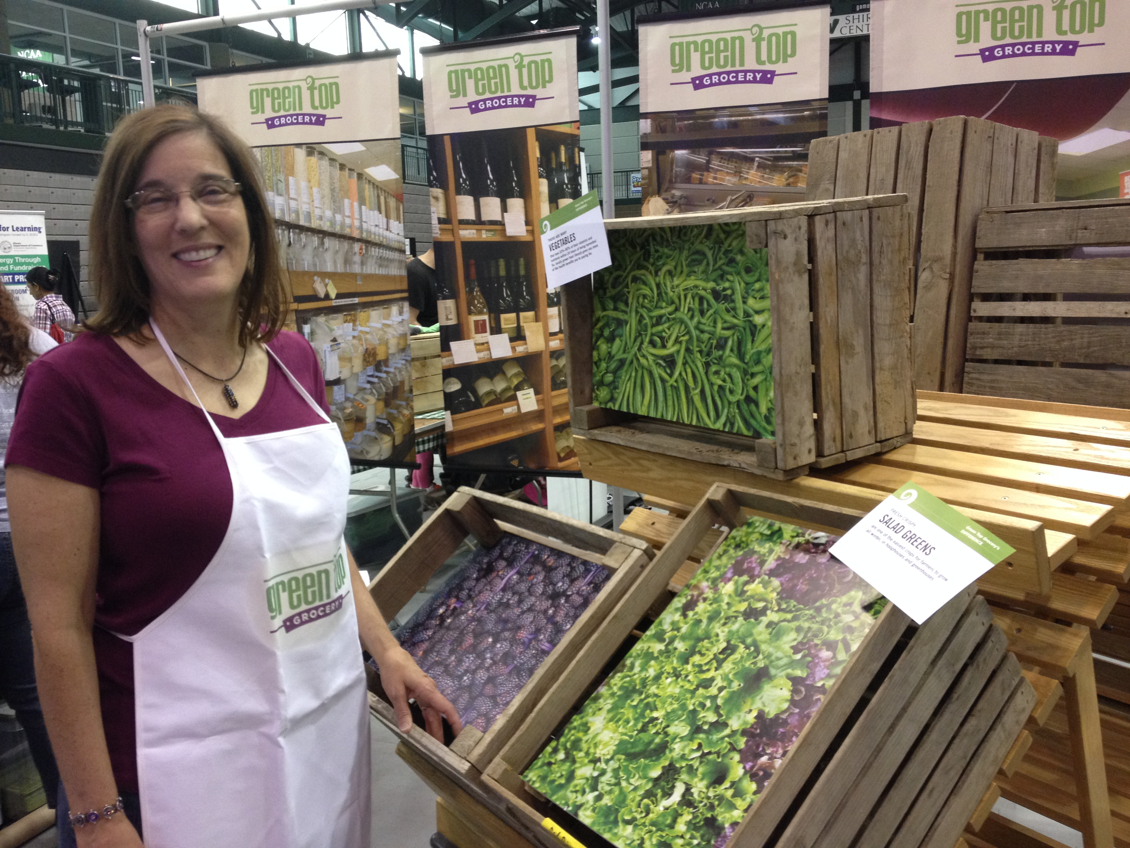
recruit

Slide 5
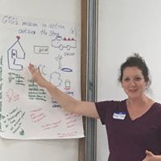
Recruit
Get in Front of People
  Co-op Meetings
    Allow time on the agenda of co-op community meetings
  Meet the Co-op Events
  Volunteer Training or Orientation
  Community Meetings (Rotary, Kiwanis)
  House Parties
Notes:
(make sure volunteer opps are part of every co-op meeting) *signup forms, allow time on the agenda of co-op community meetings

Slide 6
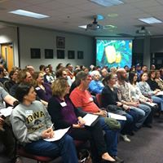
Recruit
Volunteer Training or Orientation
  Early and frequent communication about event
  Create and manage a list of potential volunteer roles
  Invite every attendee to choose their role using a sign in sheet
  Engaging & professional presentation
  Regularly scheduled
  Unique location
  Follow Up!
Notes:
Come up with a good name: Co-op 101, Coffee with the Co-op
Communication- social media, newsletter, local media, direct email communication

Slide 7

Recruit
Follow Up
  Do it. Do it. Do it.
  Use the sign up sheet to place volunteers
  Schedule a one-on one meeting if necessary
    Confirm the meeting ahead of time & let the person know how to identify you
    Show up on time/early and prepared
    Tell your co-op story
    Get to know the volunteer
    Communicate next steps
Notes:
(i’ll be wearing a GTG shirt. Or I’ll have a gtg brochure on the table)
One on one meetings are like an interview to some extent

Slide 8
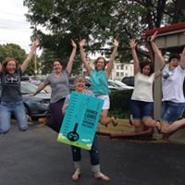
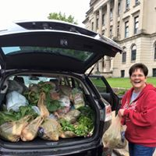
Recruit
Have FUN!
  People will join you if look like it’s fun!
  Show your passion for the co-op when recruiting volunteers.
  Post pictures of volunteers having fun!
  Post pictures of volunteers doing things outside of your co-op

Slide 9
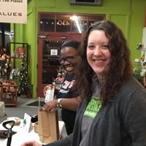
recognize

Slide 10

Recognize
  Find out how they like to be recognized
    Have volunteers fill out a form
    Use that form to thank them
  Send an email
  Handwrite a thank you note
  Involve your board
  A small token of appreciation

Slide 11
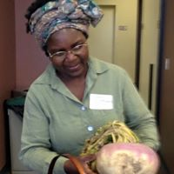
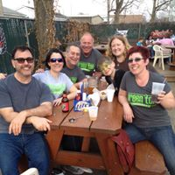
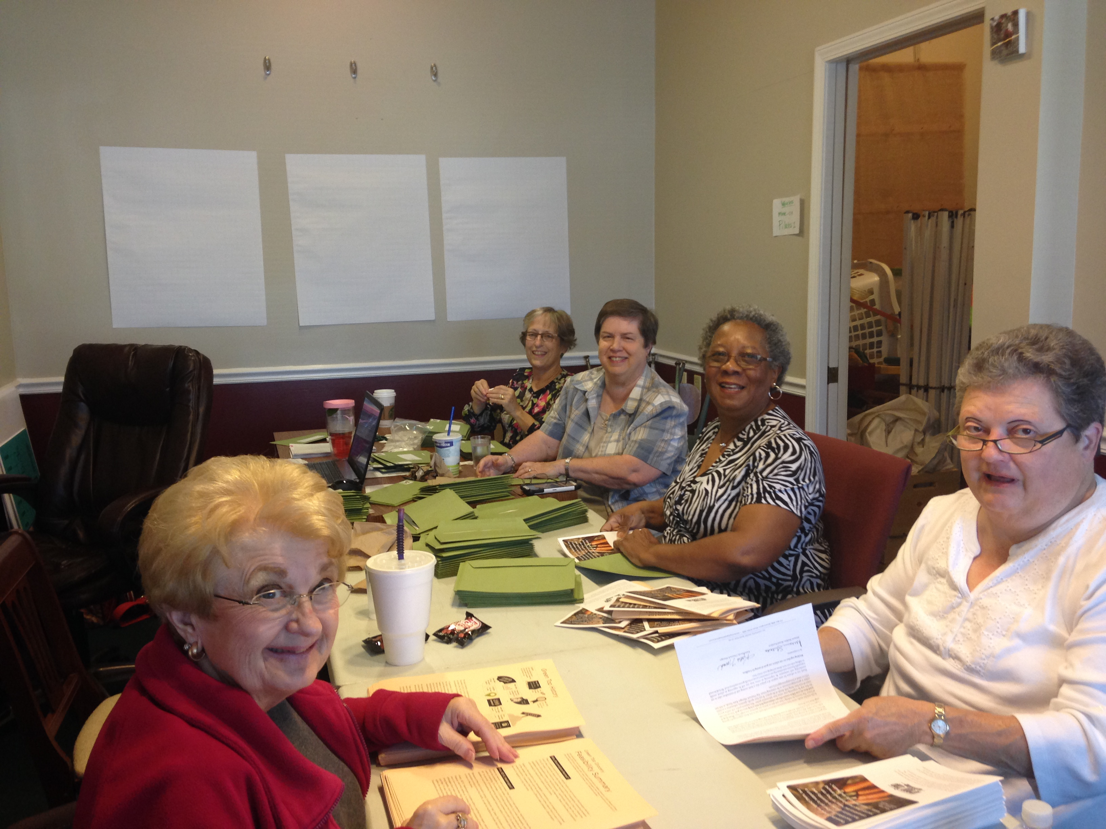
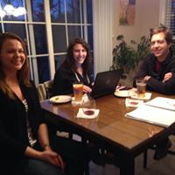
Recognize
Post pictures of volunteers in action

Slide 12
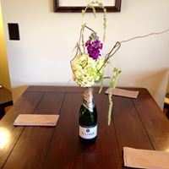
Recognize
Increase responsibility
  Keys to the office
  Approval to make purchases
Group Happy Hours
Pot luck dinners
Bring coffee or food to meetings

Slide 13
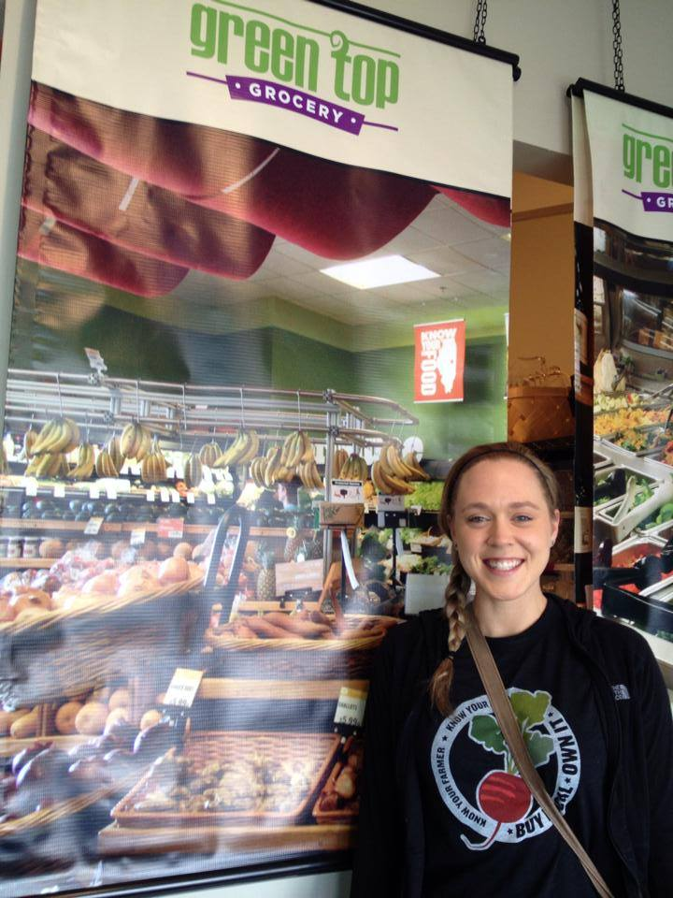
retain

Slide 14
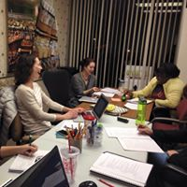
Retain
Communicate. Communicate. Communicate
Share what you can when you can
    Give the scoop
What’s happening across the organization
    Make sure that Outreach knows what Communication is working on
Hold regularly scheduled meetings
    Have an agenda
    Take & send notes, including action items
    Make time on the agenda open discussion
Discuss recent accomplishments/happenings
Review current goals and promotions

Slide 15
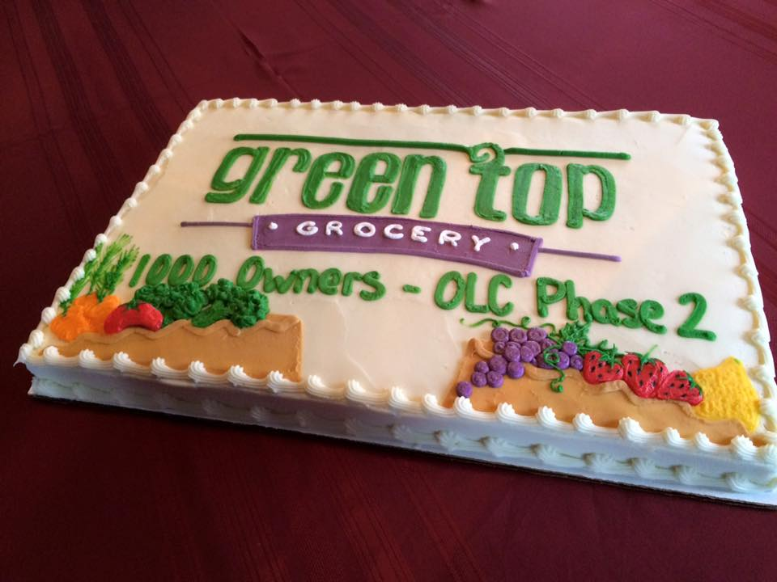
Retain
Strong Organizational Skills
Set goals and keep track of your progress
  Goals don’t have to be public
Use a shared calendar
Use project management software if you can
Stay in touch with each volunteer individually
Cake usually doesn’t hurt anything
Notes:
Goals don’t have to be public

Slide 16
Retain
Prepare Volunteers
  Email confirmation with specifics
  Introduction to lead volunteer
  Volunteer Folder
    Tips for success
    Conversation starters
    FAQ
    Instructions on how to take an application
    Instructions on how to take a payment
    Event recap
    Picture of optimal booth set up
Notes:
Specifics include:
Event details (start time, end time)
Parking
Tickets
Shirt
Lead volunteer
Other volunteers
Contact info

Slide 17
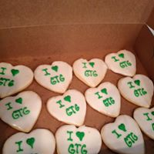
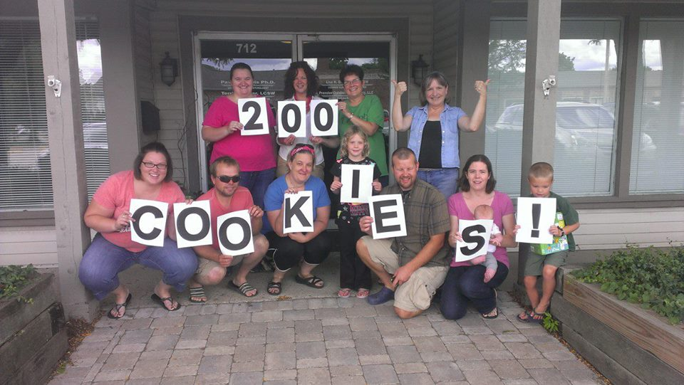
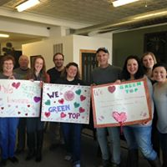
Retain
Have FUN!
  Food
  Drinks
  Laugh & have fun
  Share stories of things that went well
  Do things that aren’t co-op related
  Props or swag
  Photos
Notes:
Katie

Slide 18

Accountability
  Have a conversation
  Be respectful and kind.
  Assume responsibility
    “I may have not explained this well, I’m so sorry”
  Communicate the importance
  Thank them
  Practice- it will get easier the more you do it
Notes:
Katie- This is hard, but needs to be done.

Slide 19

Accountability
Hold Regularly Scheduled Meetings
  Create a task list
  Make the task list a standing item on the agenda
    Update the list as meeting proceeds
    Go over task list at every meeting
  Allow time for project updates
Notes:
Jerry

Slide 20

Accountability
Lead
Keep appropriate level of contact
Delegate appropriately
Appropriate oversight for newer volunteers
Demonstrate the characteristics you want your volunteers to demonstrate
Notes:
Use email, facebook, phone
Know about their lives, whats going on with them
Give the right task to the right person
Stronger connectivity to newer volunteers

Slide 21
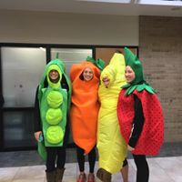
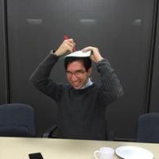
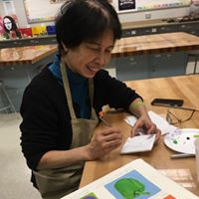
Reality Check
Notes:
Things don’t always go as planned. You’ll make mistakes. The key is to learn from them and keep at it! Volunteer management is a LOT like real-life management. It takes dedication, hard work, honesty and the ability to laugh at yourself.

Slide 22

Katie@coopcoaching.com
309-643-2176 coopcoaching.wordpress.com
Thank You

